Slide 1


COMS 4995 APPLIED MACHINE LEARNING
Trending YouTube Video Analysis
Yuren Dong (yd2620), Sumit Chavan (smc2306), Sunjana Chintala (sc4921), Yajie Zhang (yz3876), Ayush Raj (ar4283)
Project Deliverable-2

Slide 2
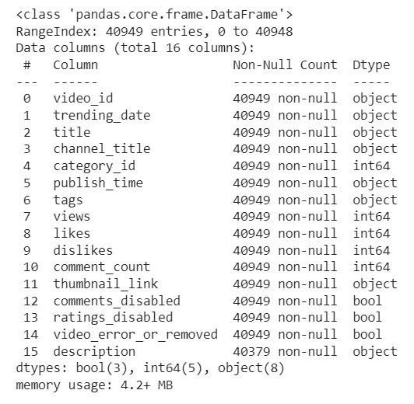
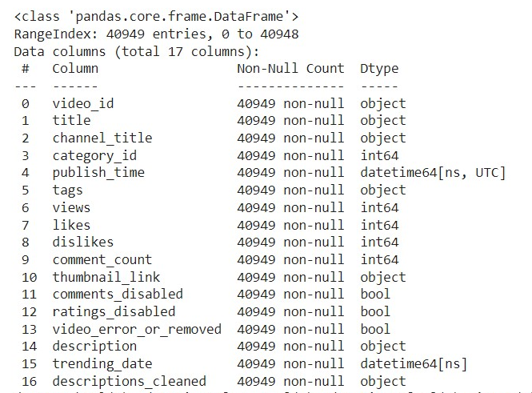
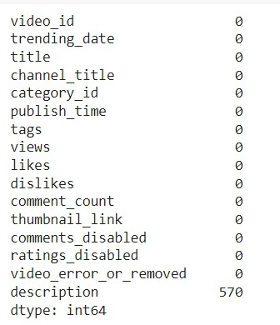
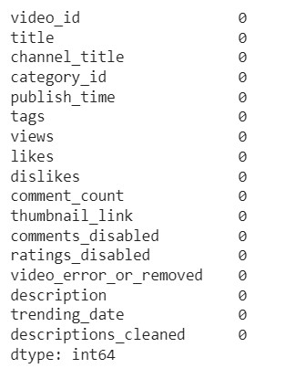
Data Cleaning and Preprocessing
The dataset consists of 40948 rows and 16 columns
Out of these, there are 8 categorical variables and 8 numeric variables
The data does not contain any missing values except for in the description column in which there are 570 missing values.
Data Cleaning and Preprocessing:
The missing values are filled with a blank(“ “)
The delimiter in “tags” column is changed to a comma to make analysis easier
The “publish_time” and “trending_date” columns are converted to standard datetime formats
The description column has languages other than english as well. These words are changed into english using google translate API

Slide 3
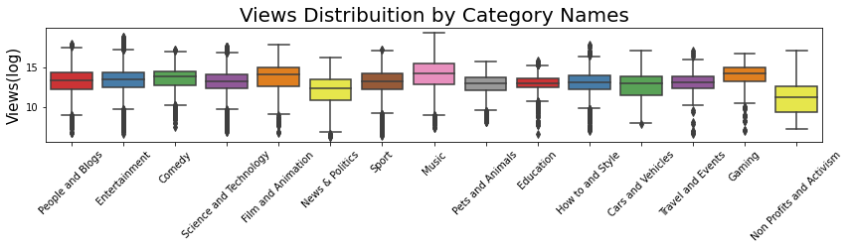
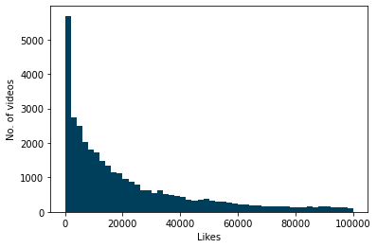
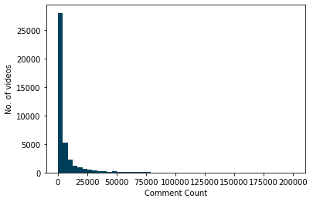
Insights from data Exploration
Significant views for music, science and film categories.
Nonprofits and activism have less views compared to other normal categories.
71% of trending videos have less than 1.5 million views, and 91% have less than 5 million views.
The majority of trending videos have 40000 likes or less with a peak for videos with 2000 likes or less.
67% of trending videos have less than 4,000 comments, and 93% have less than 25,000 comments.

Slide 4
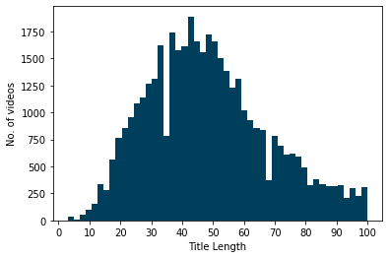
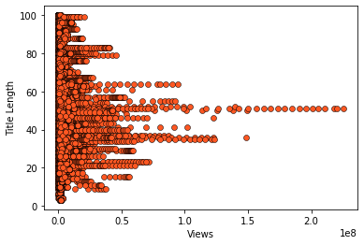
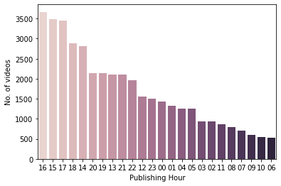
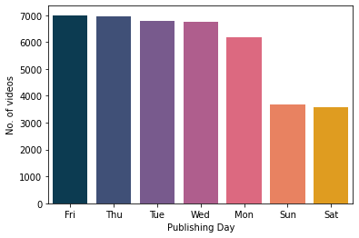
Title-length distribution resembles a normal distribution, where most videos have title lengths between 30 and 60 character approximately.
By looking at the scatter plot, we can say that there is no relationship between the title length and the number of views.
However, we notice an interesting thing: videos that have 100,000,000 views and more have title length between 33 and 55 characters approximately.
44% of trending video titles contain at least one capitalized word.
The delimiters - and | were common in trending video titles.
The words 'Official', 'Video', 'Trailer', 'How', and '2018' were common also in trending video titles.
The number of trending videos published on Sunday and Saturday are noticeably less than the number of trending videos published on other days of the week.
The period between 2PM and 7PM, peaking between 4PM and 5PM, had the largest number of trending videos.
The period between 12AM and 1PM has the smallest number of trending videos.

Slide 5
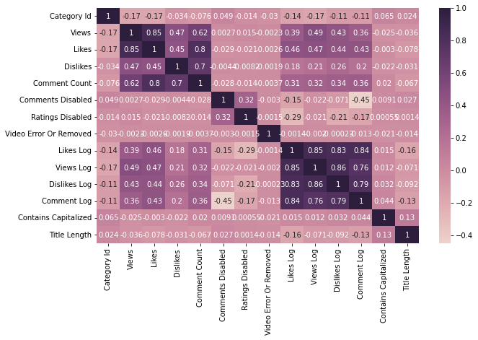
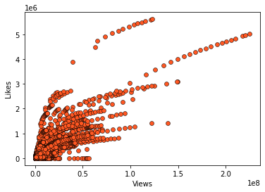
Some videos may appear on the trending videos list on more than one day. Our dataset contains 40494 entries but not for 40494 unique videos but for 6351 unique videos.
We see that views and likes are highly positively correlated with a correlation value of 0.85.
We see also a high positive correlation (0.80) between likes and comment count, and between dislikes and comment count (0.70).
There is some positive correlation between views and dislikes, between views and comment count, between likes and dislikes.
We see that views and likes are truly positively correlated: as one increases, the other increases too - mostly.

Slide 6
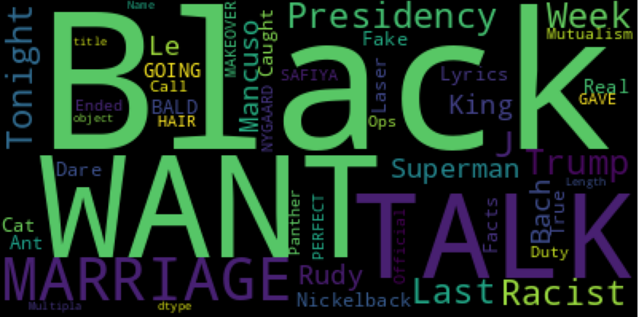
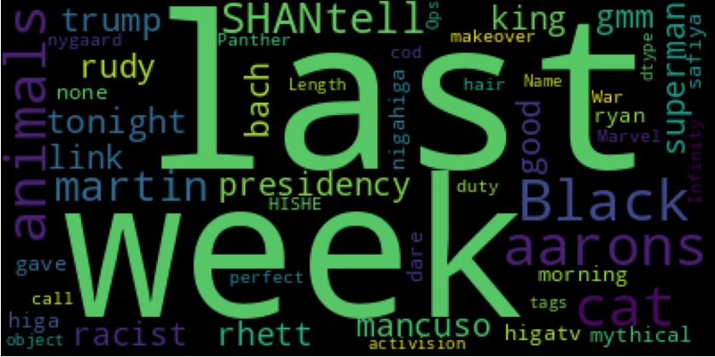
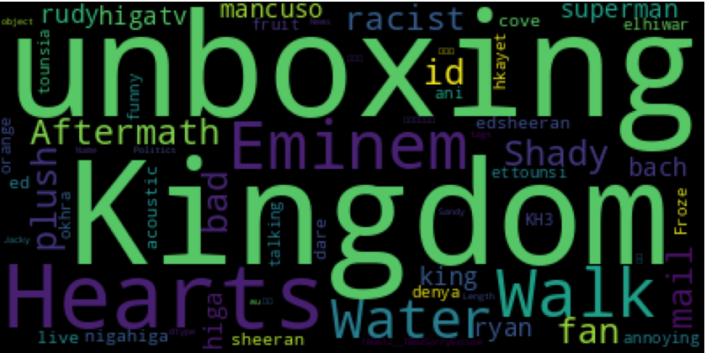
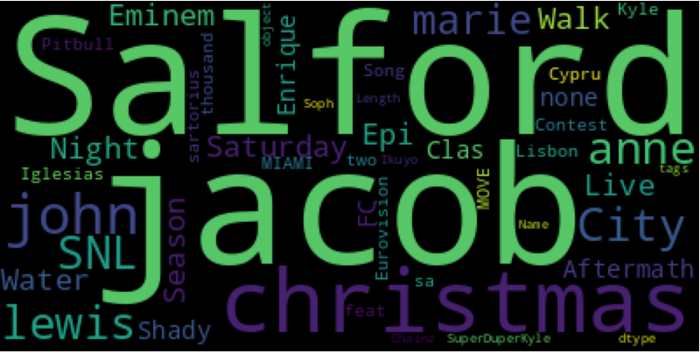
Word Cloud Analysis on Trending Video Title & Tags
In the United States, talk shows and political contents are hot topics for top trending videos on Youtube.
Audiences in the UK & Canada have obviously different tastes for hot topics when it comes to trending videos.

Slide 7
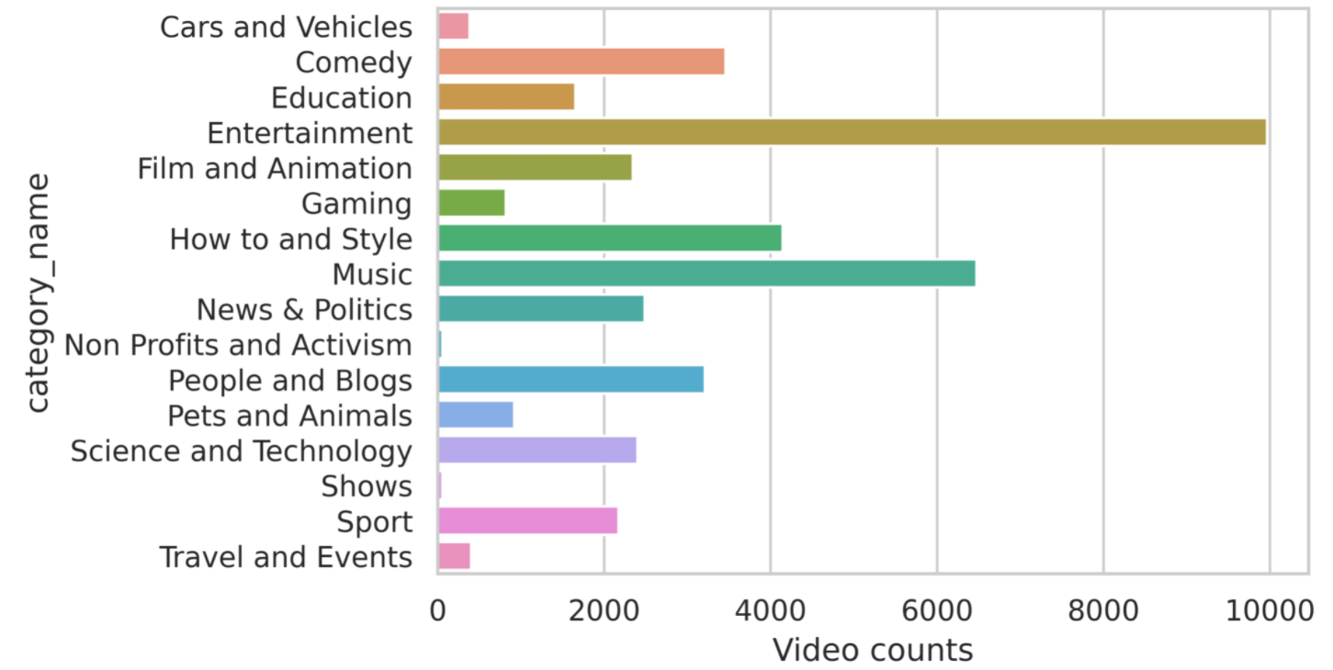
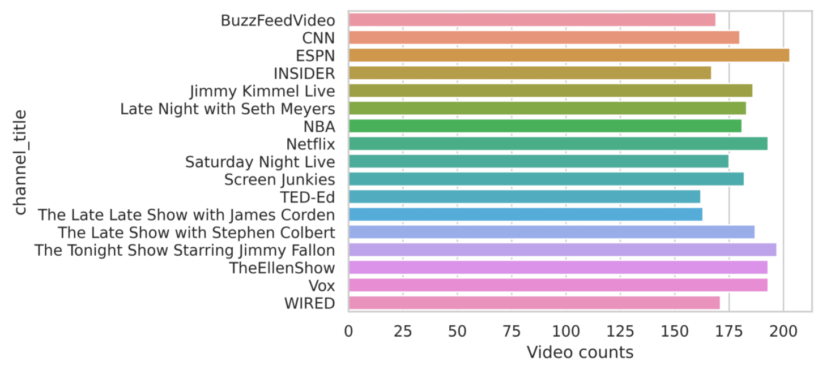
Distribution of trending videos in terms of categories & channels
The category that has the largest number of trending videos is 'Entertainment' with 9,964 videos, followed by 'Music' category with 6,472 videos, followed by 'Howto & Style' category with 4146 videos.
On the opposite side, the category that has the smallest number of trending videos is 'Shows' with 57 videos, followed by 'Nonprofits & Activisim' with 57 videos, followed by 'Autos & Vehicles' with 384 videos.
Notes:
Not all categories have trending videos. Only most popular channels are chosen for easier visibility (channels with trending videos > 160)

Slide 8
Machine Learning Approaches
What makes a video popular?
Popularity metric
Predict views, likes, and comment counts (Regression)
Keywords (Word Embedding)
Feature Importance (Important factors)
Correlation
Which videos do you like?
Content based recommendations (Classification & Regression)
Textual features (TFIDF, Regular Expressions)
Similarity Scores (Sigmoid function)
Country-specific recommendations
User Interests
Notes:
Popularity metric from views, counts, and age
How to define trending: https://support.google.com/youtube/answer/7239739?hl=en
Predict views, likes and comments
Correlation between
Category, trending duration, date/time published, views, likes, dislikes, comment count, title length, and other attributes

Slide 9
Recommendation System Structure
Use word embeddings to convert textual data into similarity matrix
cosine similarity, sigmoid function
Find the similarity score between vectors in matrix
Create functions that take user inputs
Generate the similarity score of vectors with input
Rank recommendations based on decreasing similarity with user input
Video with the highest similarity with the input appears on the top
Notes:
We use word embeddings to convert the textual data in different columns into a document matrix and use the similarity functions (like cosine similarity, sigmoid function etc.) to score the vectors in the matrix against each other to find the similarity score.
We would also create functions that take inputs from the user and based on the similarity score with the input, we recommend videos to the user.
These recommendations are ranked based on decreasing similarity with the user input (i.e. the video with the highest similarity with the input appears on the top)

Slide 10

THANK YOU!

